Slide 1
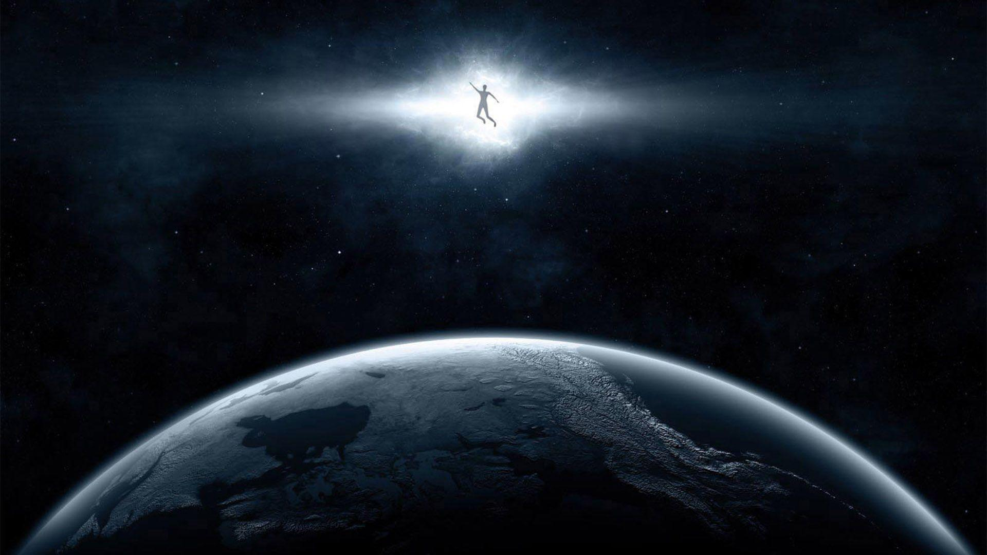
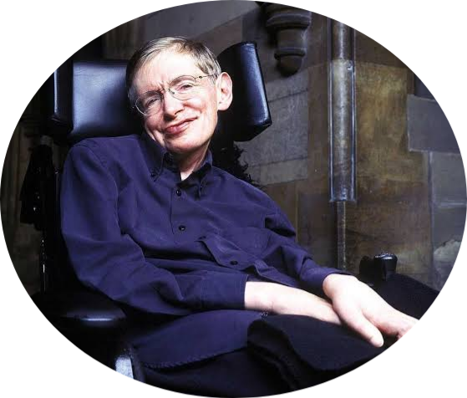
Stephen Hawking
-Positivity ‘Benchmark’

Slide 2
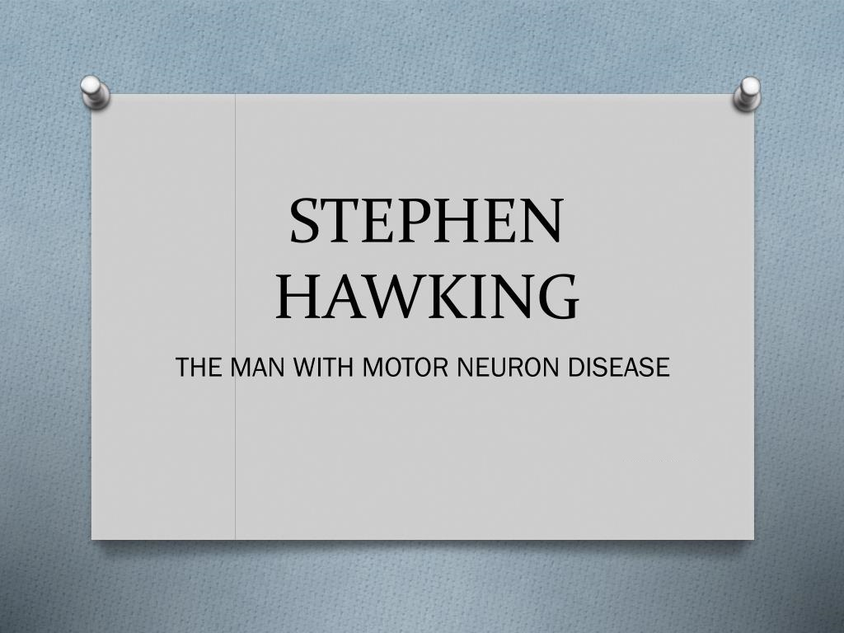

Slide 3

Early life

Slide 4

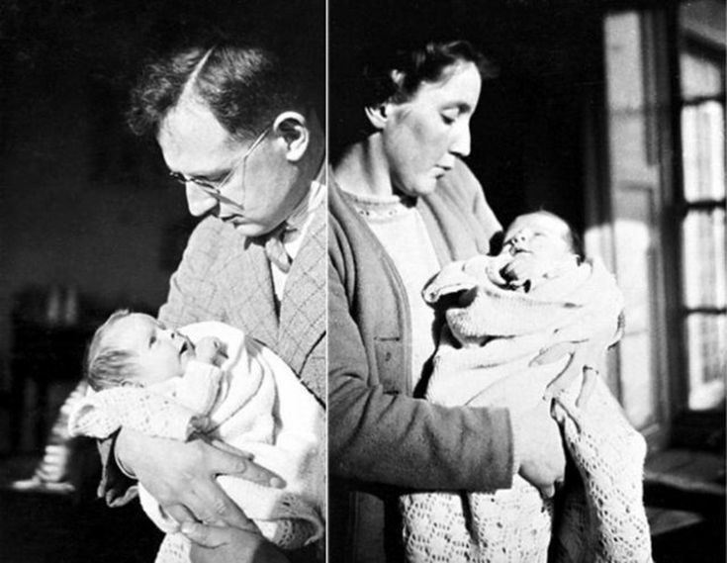
Stephen William Hawking was born on January 8 1942,in Oxford,England to Frank and Isobel.His great-grandfather went bankrupt by buying a farm land in ealry 20th century and were saved by their grandmother by opening a school in their home.
Mr Frank read medicine and Mrs Isobel read Philosophy, Politics and Economics.

Slide 5
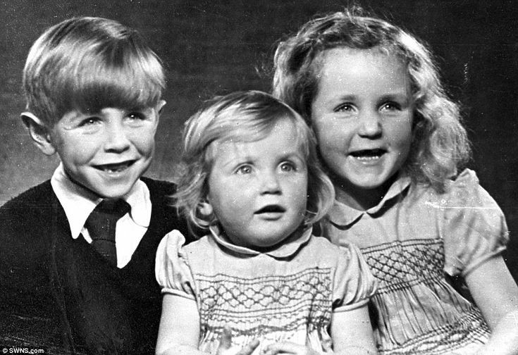
Hawking had two younger sisters, Philippa and Mary, and an adopted brother, Edward Frank David.
His father became head of the division of parasitology at the National Institute for Medical Research in 1950 and moved to St.Albans,Hertfordshire.

Slide 6
Education

Slide 7

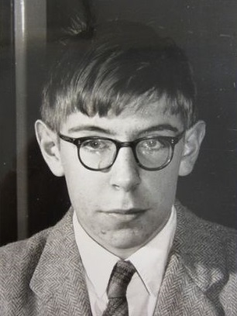
He first studied in St.Albans school.After he went to his father’s old university collage,Oxford University in 1952
He wanted to persue Mathematics and Physics and had been very good in solving problems in Mathematics and Physics.

Slide 8
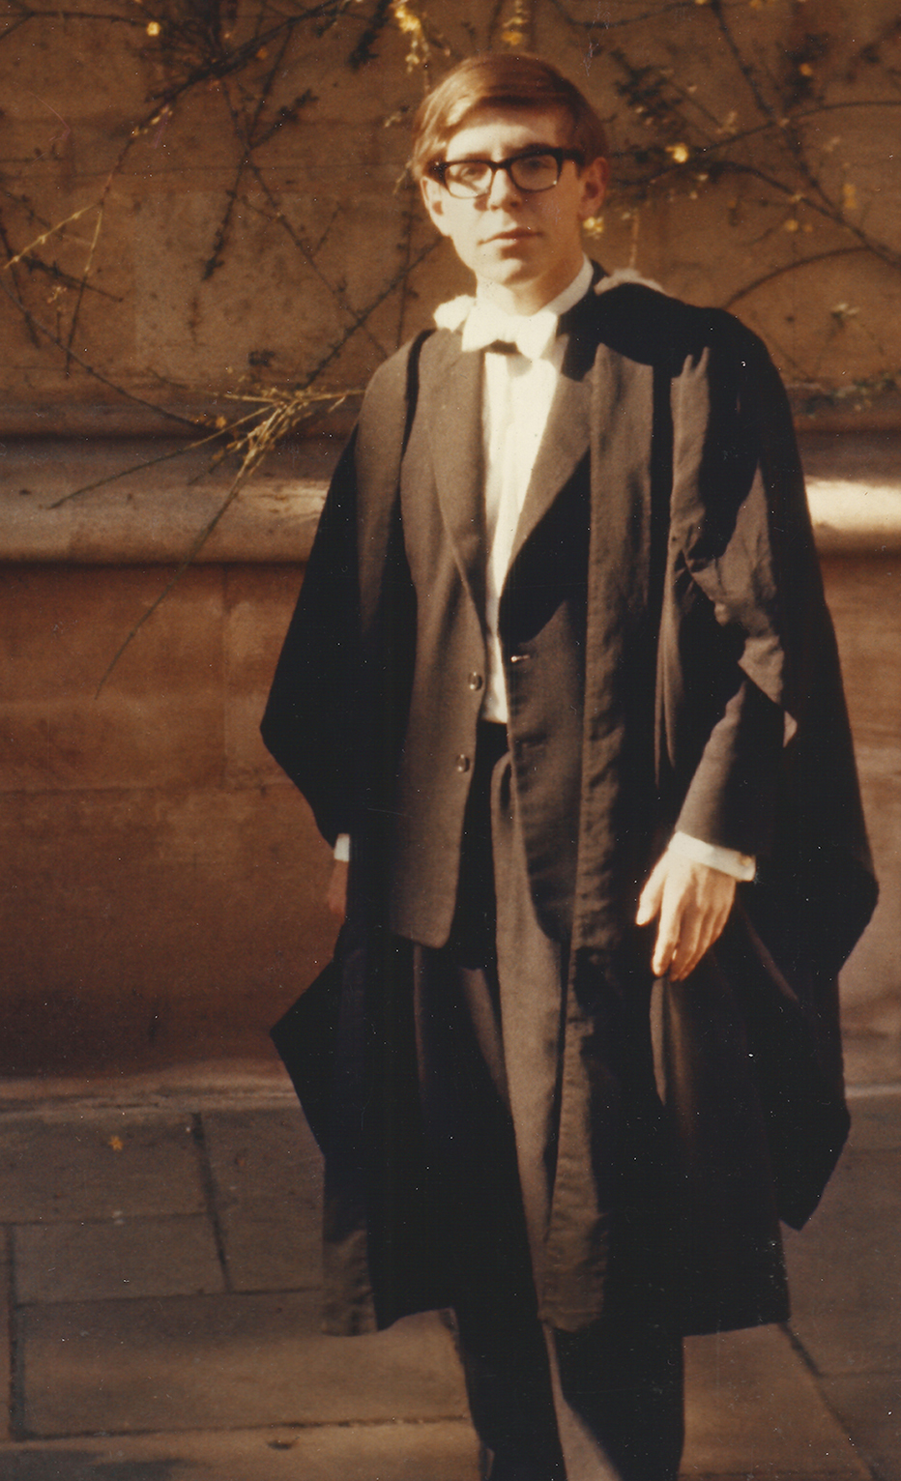
After being dedicated for three years,he has been awarded with first class honour degree in Natural Science
He received a bachelor degree in physics from Oxford University in 1962 and doctorate in physics from Trinity Hall,Cambridge in 1966

Slide 9
Personal life

Slide 10
Stephen Hawking with his wives Jane Wilde And Elaine mason

Slide 11

1962 1963
1965
1966
Met Jane during his
degree program
fell from the stairs and
diagnosied with amyotrophic lateral sclerosis disease
On 14 July,married
Jane at St.Albans
Robert Hawking-1967
Lucy Hawking-1969
Timothy Hawking-1979
He received his
doctorate

Slide 12
struck with neumonia
and was put on a 24/7
life support
1970 1985
1995
2006 2018
He was bounded to
the wheel chair
Married Elaine Mason
They were together for
11 years and devorced
Died on 14 march
at the age of 76
.

Slide 13
Contribution to the society

Slide 14
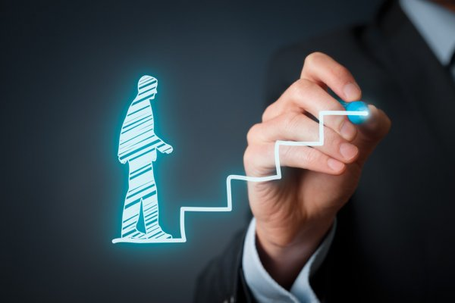
Stephen Hawking’s five main theories

Slide 15

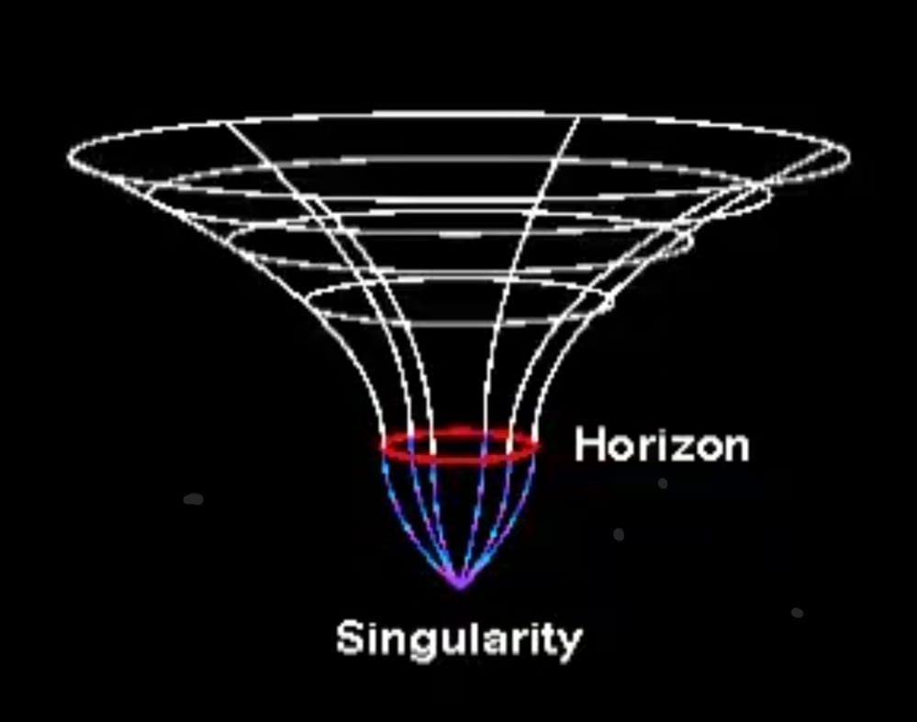
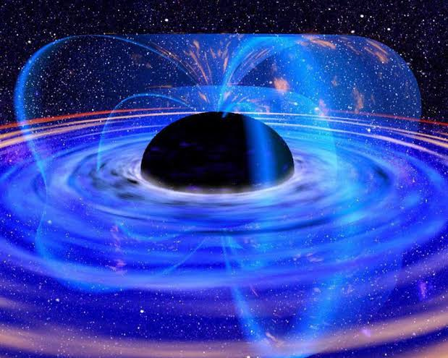
Singularities
1971
Laws of black hole mechanism
1972

Slide 16
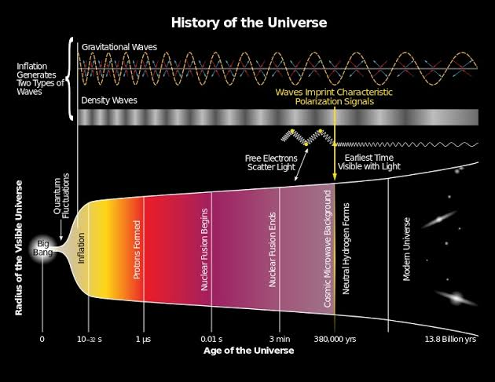
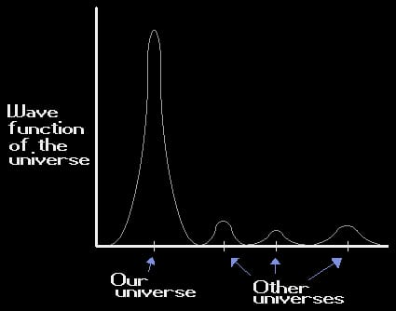
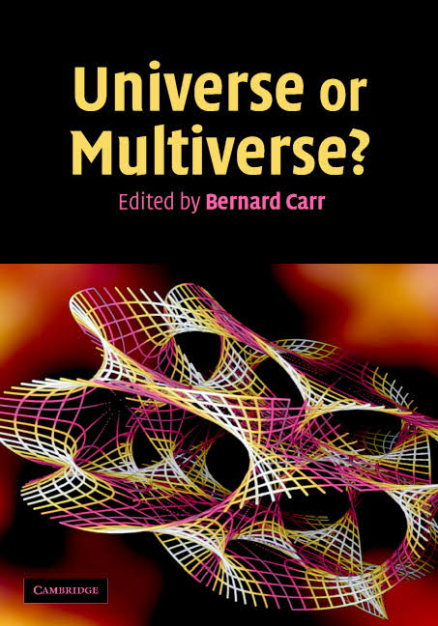
Cosmic Inflation
1982
Model on the wave function of the universe
1983
Top-Down theory on cosmology
2006

Slide 17
Awards and Rewards

Slide 18

Five major
medals Of
Stephen Hawking

Slide 19


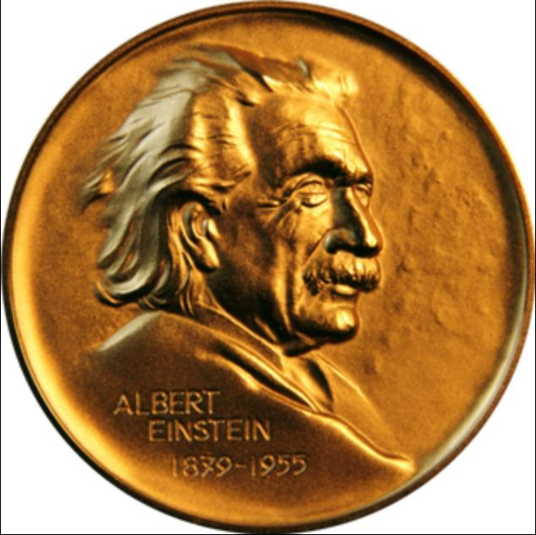

Adams prize medal
1966
Albert Einstein Award
1978
Wolf prize in physics
1988

Slide 20
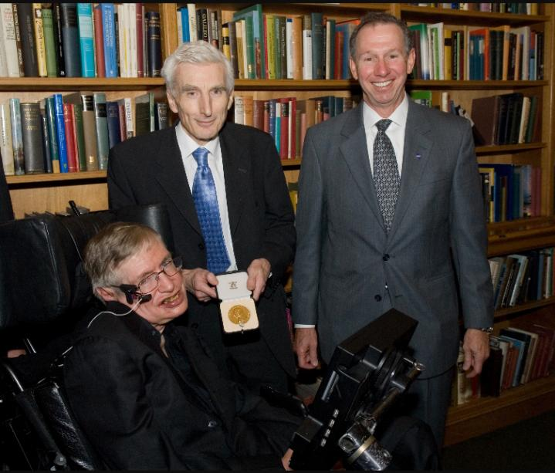
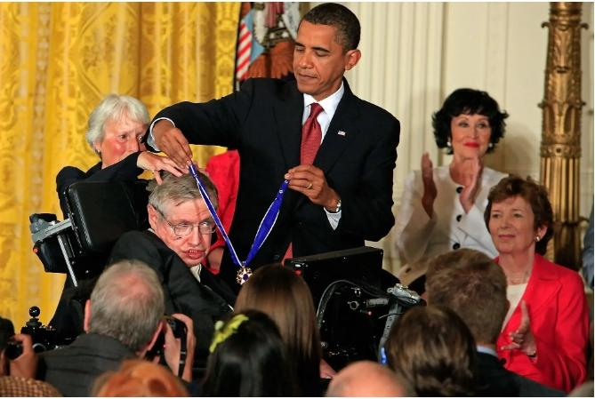
Copley medal
2006
Presidential medal
of freedom
2009

Slide 21
books and paper

Slide 22
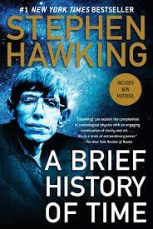
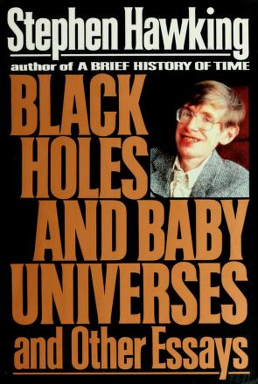
Tells about ideas of hawking
1988
Lectures and scientific thoughts of
Hawking
1993

Slide 23
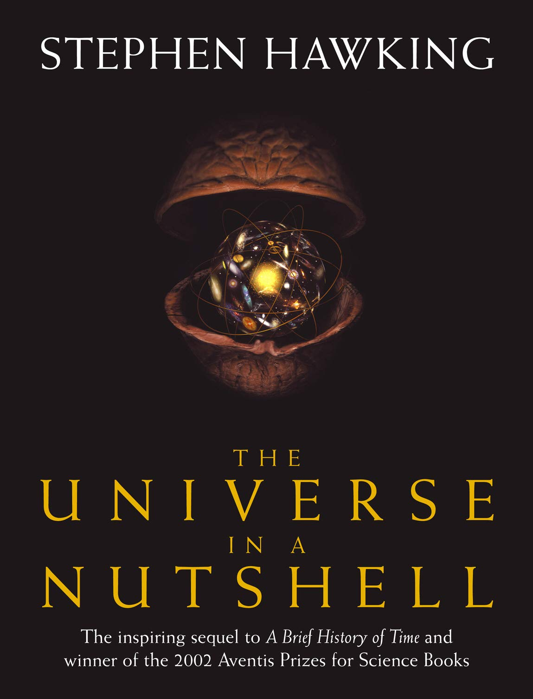
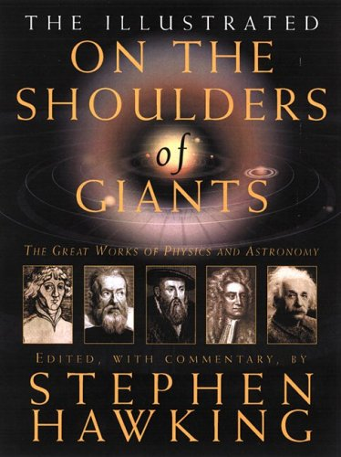
Sequal of a brief history of time
2001
Five scientists works
2002

Slide 24
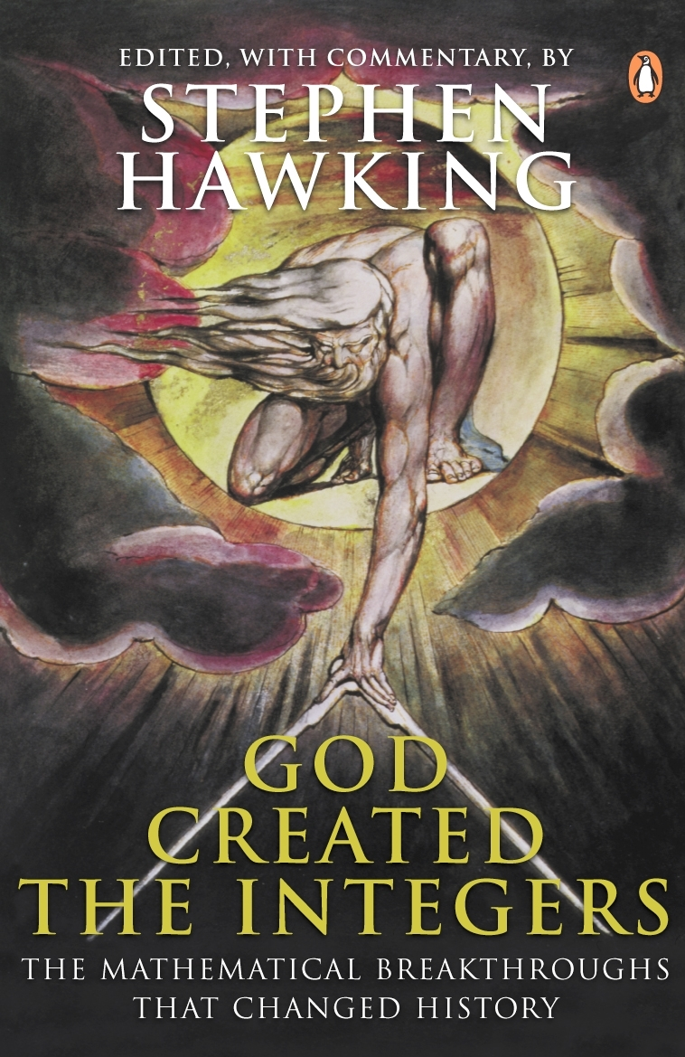
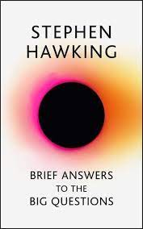
An anthology of classical works on
mathematics
2005
Profound, accessible and timely reflection
on the biggest questions in science
2018

Slide 25

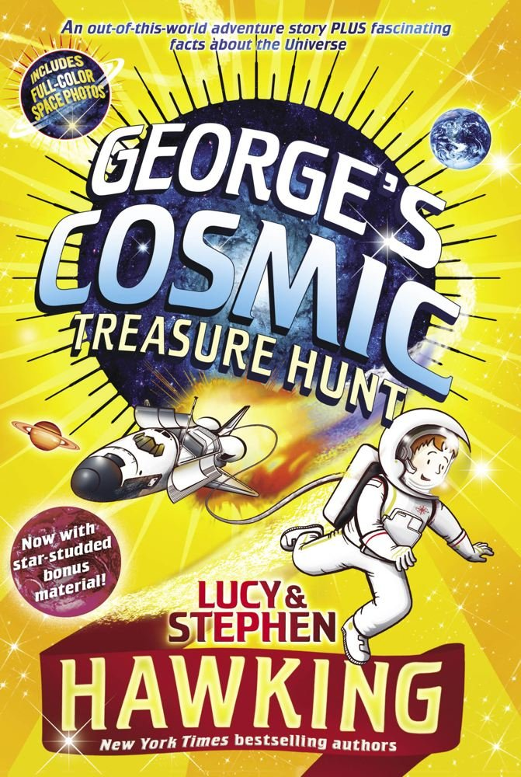
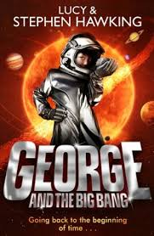
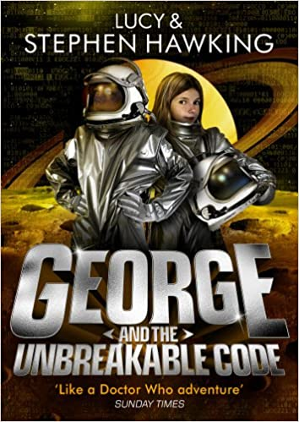
A sequel books of children fiction
Describe various aspects of the universe in a manner that is accessible to children and others new to the topic.
2007 2009 2011 2014

Slide 26
Unknown facts

Slide 27

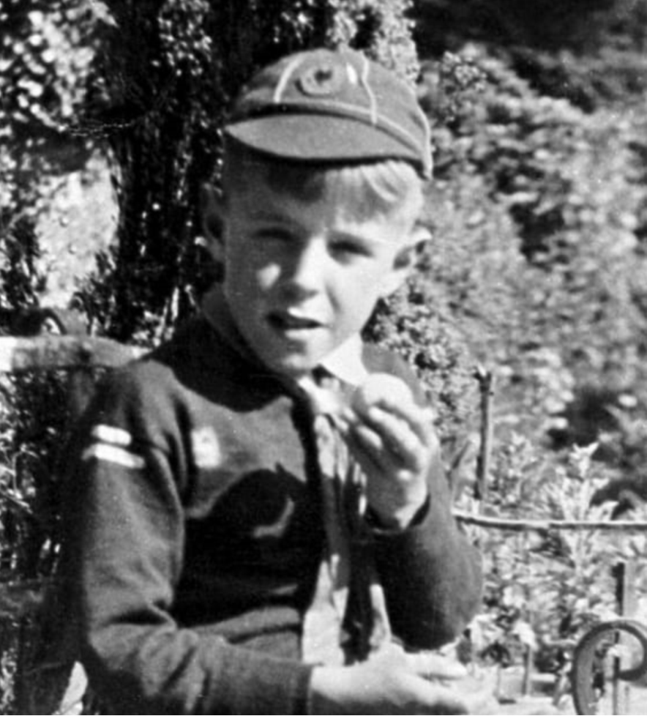
He was a pretty average student at primary school
At his early school days,he wasn’t the top of the class.However,he was always inquisitive,and his friends and teachers saw his potential and gave him the nickname,Einstein.

Slide 28
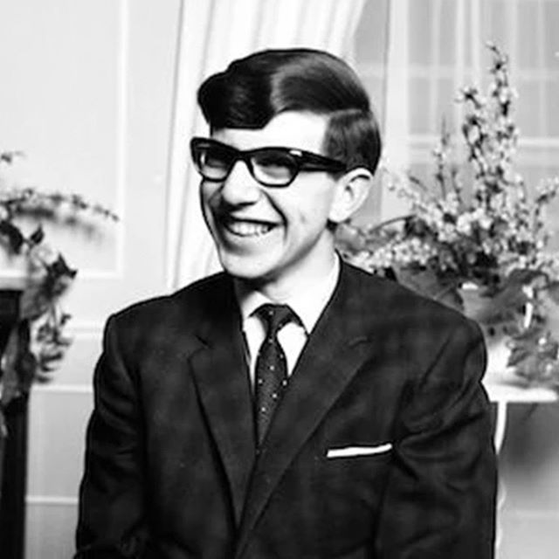
When Stephen was 21 years old,he was told that he had only few years to live
At the age of 21,his family members noticed that he was often tripping over and was generally clumsier than usual.Later,he was diagnosed with amytrophic lateral sclerosis and he had been told that he has only two more years to live.

Slide 29
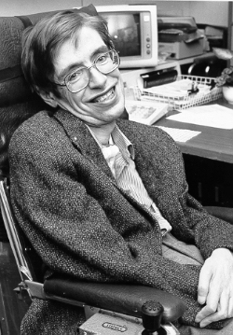
Story behind stephen loosing his speech
At the age of 43,he conracted pneumonia and prognosis looked too bad.He had undergone a tracheotomy to allow him to breath,which involved cutting an incision into the windpipe.

Slide 30
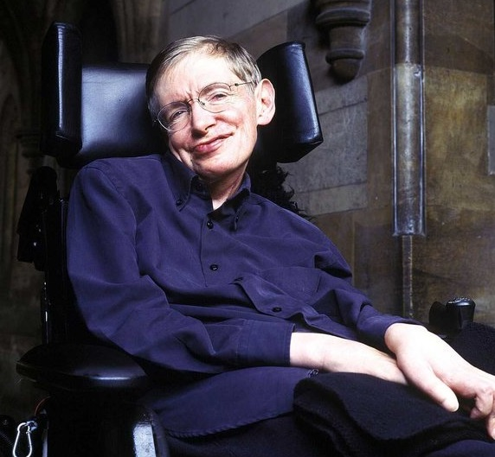
He favoured the American accent
After surgery,he no longer able to speak and used a device called equilizer to communicate.It has only American accent,and it grew on Stephen.He felt a better voice in American accent.

Slide 31
Rare pics of Hawking

Slide 32

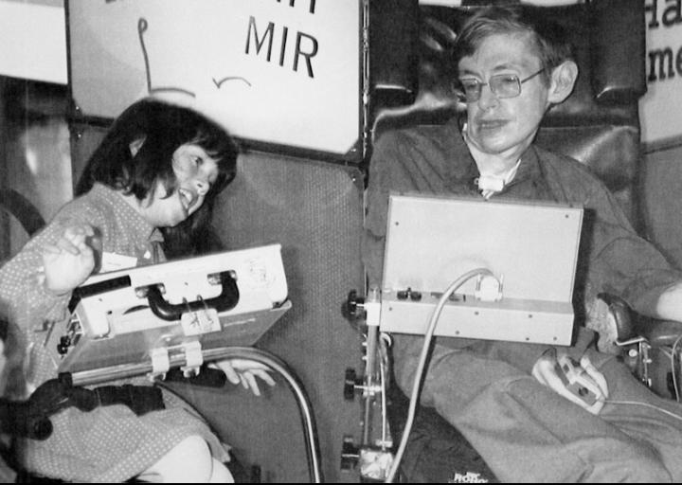
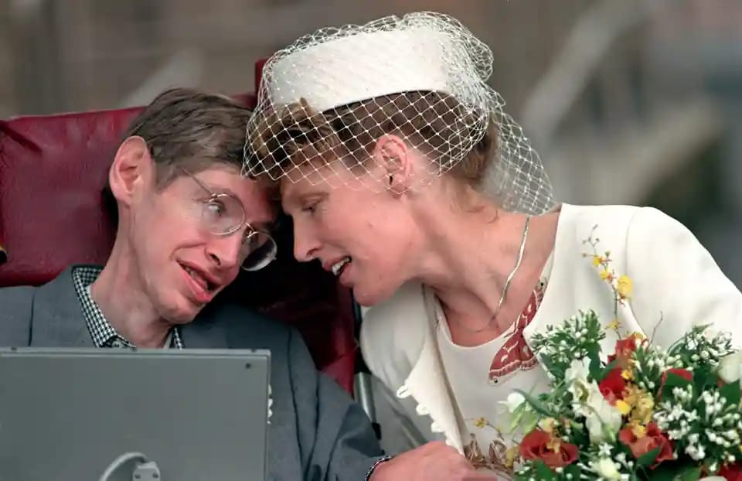
Interaction with a child
at an exhibition
Stephen Hawking with
his second wife....

Slide 33
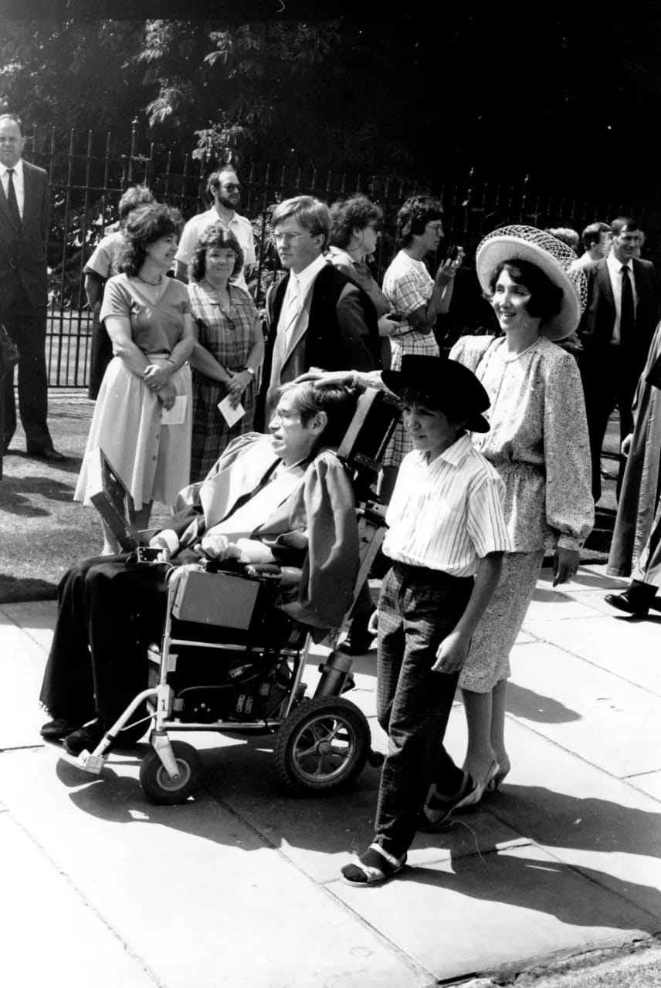
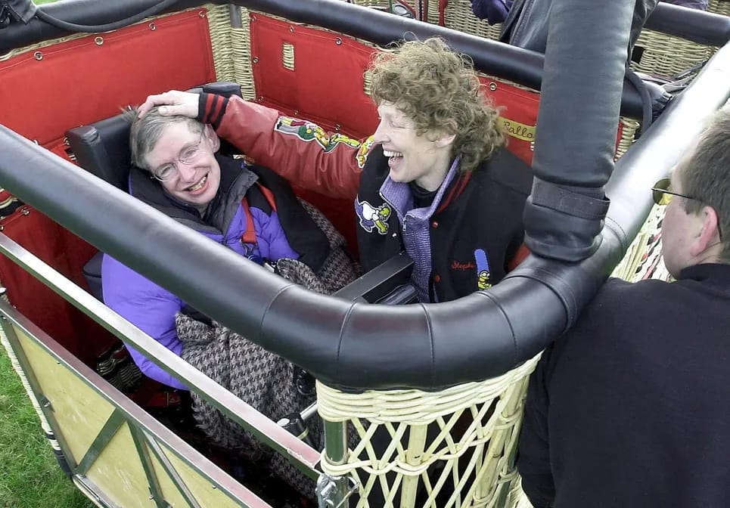
Stephen Hawking with his family....
A trip in a hot air balloon....

Slide 34
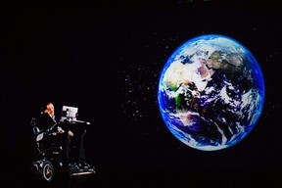
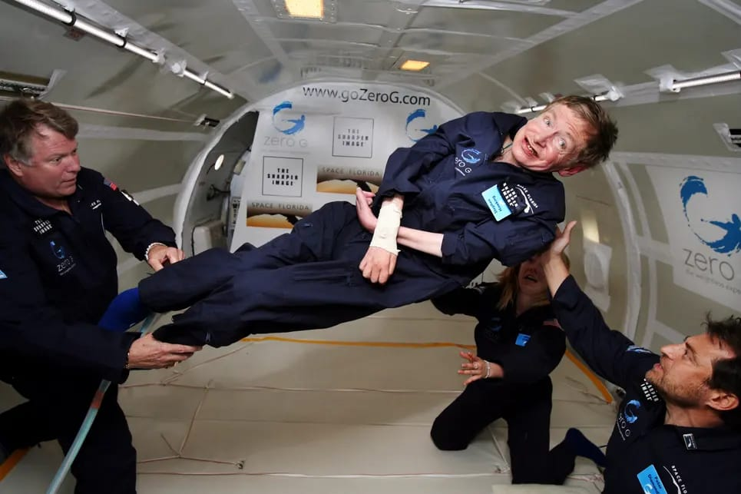
Speech by Hawking using
a hologram....
Floating in a zero-gravity jet....

Slide 35
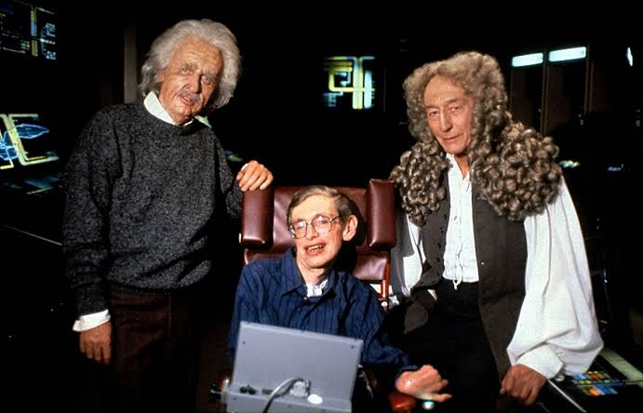
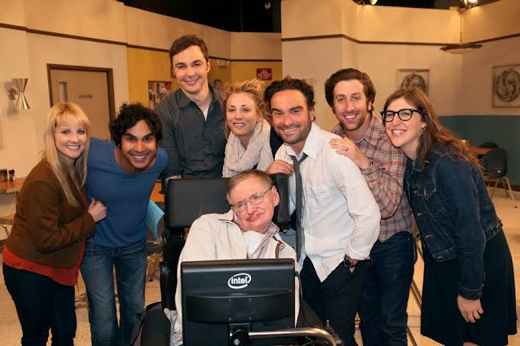
Hawking with Sir Isaac Newton and
Albert Einstein....
Hawking acted as himself in
a cameo role....

Slide 36

Vocabulary

Slide 37

1.Parasitology:
Study of parasites, their hosts, and the relationship between them.
2.Persue:
To continue with or to try to get someone or something.
Usage:You said there was a reason for them to pursue this?
3.Zest:
A feeling of enjoyment and enthusiasm for life.
Usage:Her zest for life is as great as ever.
4.Prognosis:
The likely course of a medical condition
Usage:After being hit by a car, the small dog's health prognosis was not good
5.Crumbled:
Cause (something) to break apart into small fragments.
Usage:The Empire crumbled away by degrees

Slide 38
Stephen Hawking’s eight lessons

Slide 39


Was Stephen Hawking really
“Disabled”

Slide 40
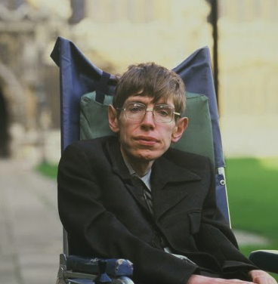


He explained the power of technology to transform lives,communicate ideas which leads to great discoveries.
After he had been diagnosed with ALS and with only a few to live,he flung himself into his work and research as a physicist.

Slide 41
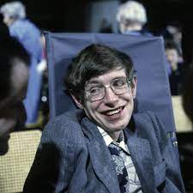


He had a childlike curiosity in that he was always asking questions with ‘why’and ‘how’
He always play jokes on himself about his zany appearance.

Slide 42
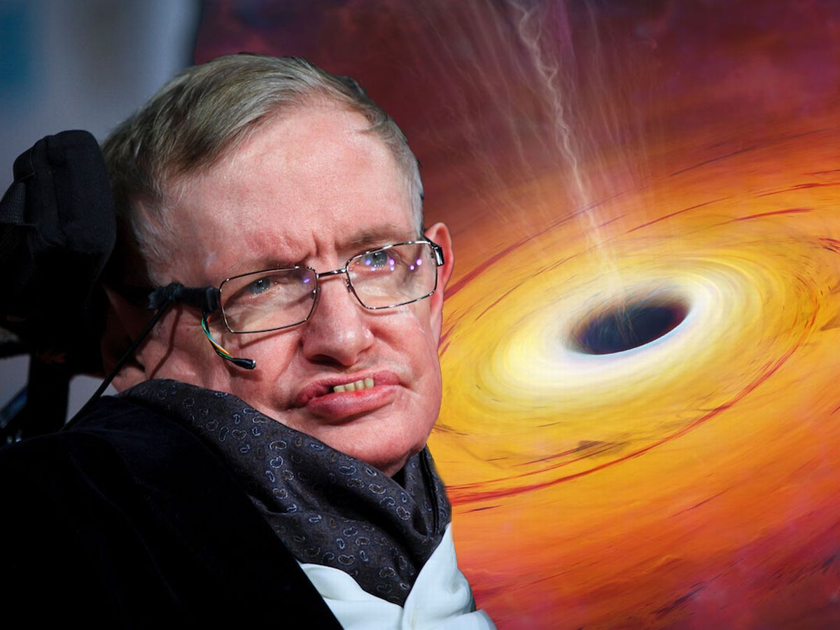


He has been concerned about the lack and mismanagement of funding for scientific research.
He never gave up inspite of criticism and controversy about his study of black holes.

Slide 43
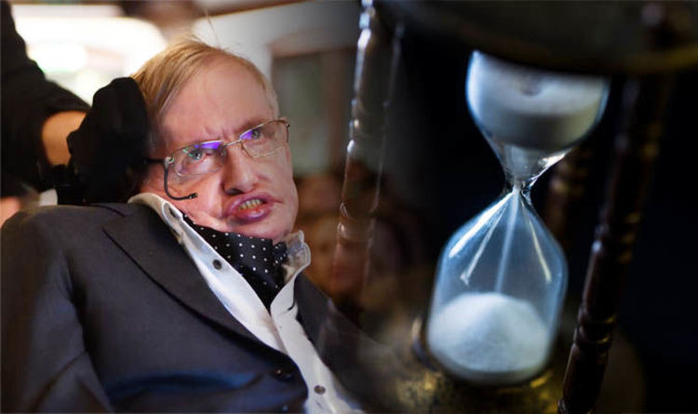


His study on time by remarking that it would be impossible to turn back the clock.
Hawking firmly believed that knowledge was to be shared.His ambition was that his books would be widely read.

Slide 44
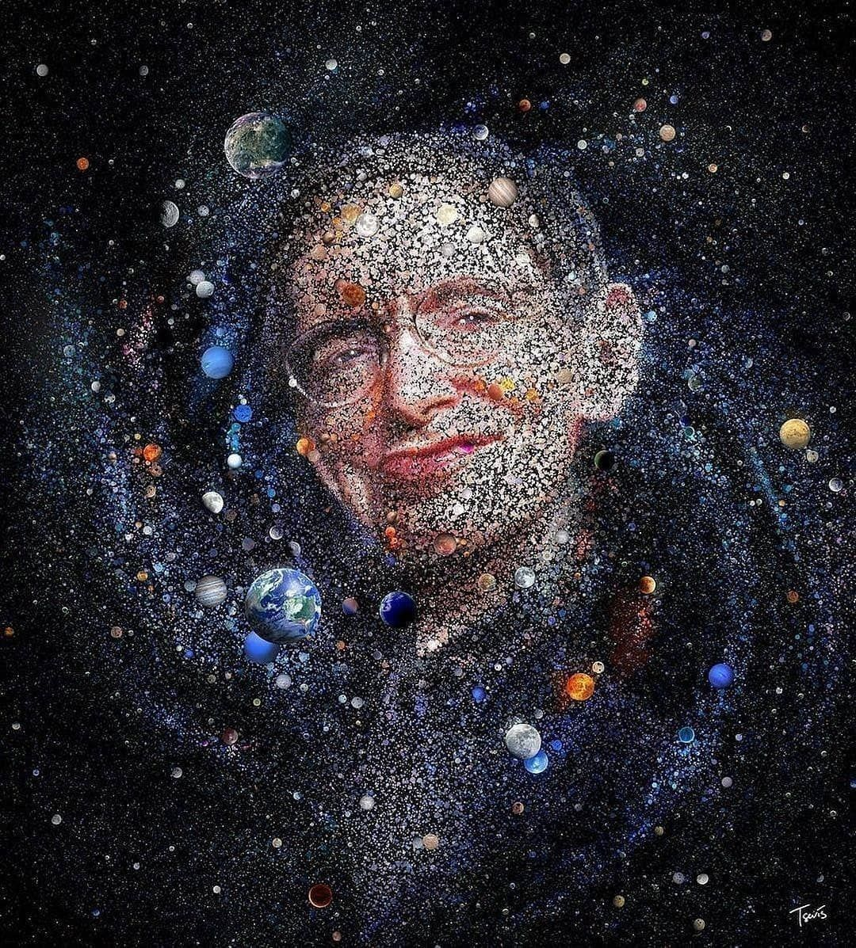
Presented by: 1.Divya 2.Rohit 3.Jhansi 4.Uma Prasanna 5.Ganesh 6.Sanjay 7.Siva Shankar 8.Naga Lakshmi 9.Devika 10.Renu Sri “My advice to other disabled people would be,concentrate on things your disability dosen’t prevent you doing well,and don’t regret the things it interferes with.Don’t be disabled in spirit as well as physically.” -Stephen Hawking

